Slide 2
R Environment
R studio (http://www.rstudio.com/)
Notepad++ (http://notepad-plus-plus.org/) and R (http://cran.r-project.org/bin/windows/base/)
install.packages("installr")
library(installr)
updateR()

Slide 3
Hello world!
"Hello world!"
cat(“Hello World!”)
a<-”Hello World!”
cat(a)
(a<-”Hello World!”)

Slide 4
Control structure: if
if(x<5)y<-0
if(x<5){
reduction<-20000
}else if(x<10){
reduction<-90000
}else{
...
}

Slide 5
User defined function
small<-function(a,b,c){
...
}
small(100,-1,30)
Notes:
Smallest of 3 numbers

Slide 6
User defined function
small<-function(a,b){
...
return x;
}
small(100,-1)
Practice 1: define function small so it returns the smaller of a,b

Slide 7
Practice 1
small<-function(a,b){
if(a>b){
return(b)
}else{
return(a)
}
}
small(100,-1)

Slide 8
Loop structure
for(i in 1:100){
...
}

Slide 9
Basic data types
numeric: x<-2.5
integer: as.integer(x)
logical: TRUE FALSE
factor: factor(c("M","F")) factor(c(4,6,8))
character: s<-"R programming"
as.numeric, as.integer, as.character, as.factor, as.Date...
class(x)

Slide 10
Vector
c(1,2,3,4,5)
1:100
c(“a1”,”a2”,”a3”,”a4”,”a5”)
vec<-1:100
vec+1
vec-2
vec*2

Slide 11
Vector operations
vec<-1:100
vec[1:50]
vec[50]
length(vec)
vec2<- 10:-10
(vec3<-c(vec,vec2))
intersect(vec,vec2)
setdiff(vec,vec2)
vec2>0
vec2[vec2>0]
which(vec3==2)
vec %in% vec2

Slide 12
Practice 2
v1<-1:100
v2<-(1:20)^3
add up numbers that are greater than 50 in both v1 and v2?
Hint: you can use the sum function.

Slide 13
Practice 2
v1<-1:100
v2<-(1:20)^3
add up numbers >50 in both v1 and v2?
v3<-c(v1,v2)
sum(v3[v3>50])

Slide 14
How to trouble shoot?
Trace your variables: cat()
Find what you have: objects() ls()
Find types of your data: class()
Summary of your data: str() summary()
? for help
traceback() browser()

Slide 15
Missing values
NA
is.na()
na.omit()
Example: x<-c(1,2,3,0,NA,10,NA)
try: x>3; x+3; sum(x),
sum(na.omit(x))
sum(x,na.rm=T)

Slide 16
Practice: sum up the numbers in a vector
x<-c(1,2,3,"unk","unknown","60")

Slide 17
Practice: sum up the numbers in a vector
x<-c(1,2,3,"unk","unknown","60")
sum(as.numeric(x),na.rm=T)

Slide 18
dataframe in R
https://github.com/lijian007/RClass.git
Click"RClass.zip", then click "Raw" to download it.
Extract files to C:/temp/RClass

Slide 19
Read data from disk
infile="C:/temp/RClass/BreastCancerPatientInfo.txt"
pts<-read.table(infile,header=T,sep="\t",quote="\"",comment.char = "", stringsAsFactors=FALSE, blank.lines.skip=T)
Data files adapted from Applied Survival Analysis: Regression Modeling of
Time to Event Data: Second Edition by Hosmer, Lemeshow and May

Slide 20
Write table to disk
write.table(df,file=outfile,row.names=F,quote=F,sep="\t")

Slide 21
Evaluate the data frame
head(pts)
dim(pts)
colnames(pts)
str(pts)
pts$grade
table(pts$grade)
nrow(pts), ncol(pts)
Notes:
menopause: 1: pre, 2: post

Slide 22
Access data in the data frame
pts[,]
pts[2,3]
pts[2,]
pts[,2]: class(pts[,2])
pts[2]:class(pts[2]), head(pts[2])
pts[[2]]:class(pts[[2]])
pts[1:20,]
pts[2:5,1:4]
pts[,c(3,4,6)]: head(pts[,c(3,4,6)])
pts$grade
pts[,"grade"]
pts[,c("MRN","grade")]

Slide 23
Edit the data frame
fix(pts)
edit(pts)

Slide 24
Find MRN 759011's tumor grade and DOB?

Slide 25
Find MRN 759011's tumor grade and DOB?
pts[pts$MRN==759011,c("MRN","grade","DOB")]

Slide 26
Read excel table
requires Perl in the system
install.packages("gdata")
require(gdata)
infile<-"C:/temp/RClass/CriticalDates.xlsx"
dates<-read.xls(infile, sheet=1, stringsAsFactors=FALSE)
OR
infile<-"C:/temp/RClass/CriticalDates.txt"
dates<-read.table(infile,header=T,sep="\t",quote="\"",comment.char = "", stringsAsFactors=FALSE, blank.lines.skip=T)

Slide 27
Merge two tables
ptm<-merge(pts,dates,by="ID")
The syntax of merge:
merge(x, y, by = intersect(names(x), names(y)), by.x = by, by.y = by, all = FALSE, all.x = all, all.y = all, sort = TRUE, suffixes = c(".x",".y"), incomparables = NULL, ...)

Slide 28
Find patient names with nodes>20

Slide 29
Find patient names with nodes>20
largenodes<-ptm[ptm$nodes>20,"Name"]
largenodes
How to list the patient names and node numbers for those nodes>20?

Slide 30
Find patient names with nodes>20
How to list the names along with the nodes number ?
largenodes<-ptm[ptm$nodes>20,c("Name","nodes")]
largenodes

Slide 31
apply family function: sapply
x <- 1:10
sapply(x, sqrt)

Slide 32
calculat the medians of column 5-10 in pts
apply(pts[,5:10],2,median)
Notes:
infile="C:/temp/RClass/BreastCancerPatientInfo.txt"
pts<-read.table(infile,header=T,sep="\t",quote="\"",comment.char = "", stringsAsFactors=FALSE, blank.lines.skip=T)

Slide 33
Graphics and Statistical tests
mtcar: a data frame with 32 observations on 11 variables.
[, 1]mpg Miles/(US) gallon
[, 2]cyl Number of cylinders
[, 3]disp Displacement (cu.in.)
[, 4]hp Gross horsepower
[, 5]drat Rear axle ratio
[, 6]wt Weight (lb/1000)
[, 7]qsec 1/4 mile time
[, 8]vs engine style (0=vertical, 1=straight)
[, 9]am Transmission (0 = automatic, 1 = manual)
[,10]gear Number of forward gears
[,11]carb Number of carburetors
1974 Motor Trend

Slide 34
Graphics in base R
head(mtcars)
try:
plot(mtcars$mpg)
plot(sort(mtcars$mpg))

Slide 35
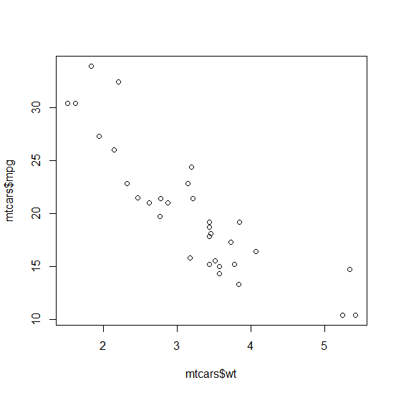
Scatter plot
Is there a relationship between mpg and wt?
plot(mtcars$wt ,mtcars$mpg)

Slide 36
How to save a graph?
File->save
or by codes:
png(“.../mygraph.png”, width=5, height=5, units="in", res=300)
plot(mtcars$mpg,mtcars$wt)
dev.off()

Slide 37
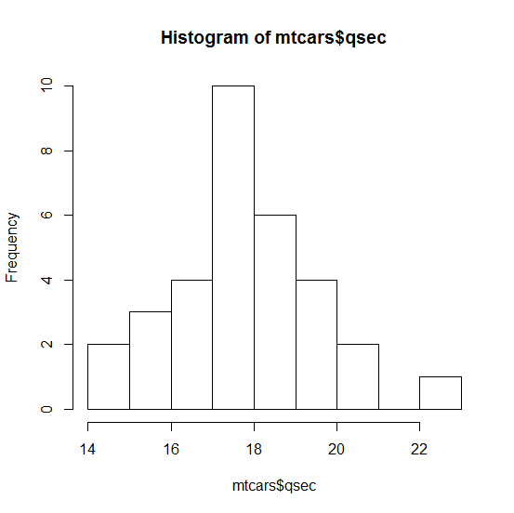
Histogram:What's the distribution of qsec?
hist(mtcars$qsec)

Slide 38
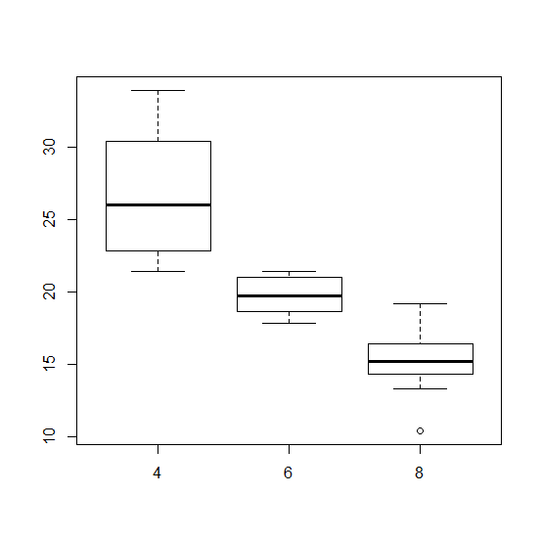
What’s the relationship between mpg and cyl (boxplot)?
plot(mtcars$cyl, mtcars$mpg)
boxplot(mpg~cyl,data=mtcars)

Slide 39
Are vertical engines (vs=0) more efficient than straight engines(vs=1)?
plot(mtcars$vs ,mtcars$mpg)
plot(factor(mtcars$vs),mtcars$mpg)
dichotomous predictor, continuous outcome
t test
t.test(mpg~vs,data=mtcars)
Confounders?

Slide 40
Is wt and mpg correlated?
plot(mtcars$wt ,mtcars$mpg,xlim=c(0,8),ylim=c(0,40))
continuous predictor, continuous outcome
linear regression
fit<-lm(mpg~wt,data=mtcars)
summary(fit)
abline(fit, col="blue")

Slide 41
Is cyl related to qsec?
plot(factor(mtcars$cyl) ,mtcars$qsec)
categorical predictor, continuous outcome
anova test
anova(lm(mpg~factor(cyl),data=mtcars))
summary(aov(mpg~factor(cyl),data=mtcars))

Slide 42
Is vs related to cyl?
plot(factor(mtcars$vs),mtcars$cyl)
table(mtcars$vs,mtcars$cyl)
categorical predictor, dichotomous outcome
Fisher's exact test
fisher.test(mtcars$vs,mtcars$cyl)

